Slide 1
Facial Recognition Project
Group 3 Chen Li

Slide 2
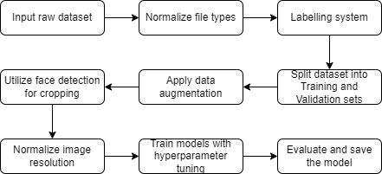
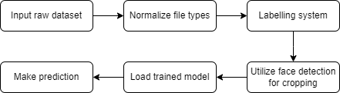
System Overview and Objective
Objective: Develop a facial recognition system using a provided dataset.
Training Flowchart
Testing Flowchart
Chen Li

Slide 3
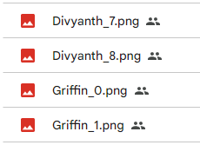

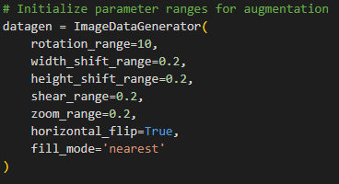
Data Manipulation
Data was first reorganized into a flattened database with consistent file names and formats (e.g. Griffin_0.png)
Data augmentation was applied after splitting the dataset into training and validation sets.
After preprocessing, the datasets were cleaned manually of any poor quality images.
Chen Li

Slide 4
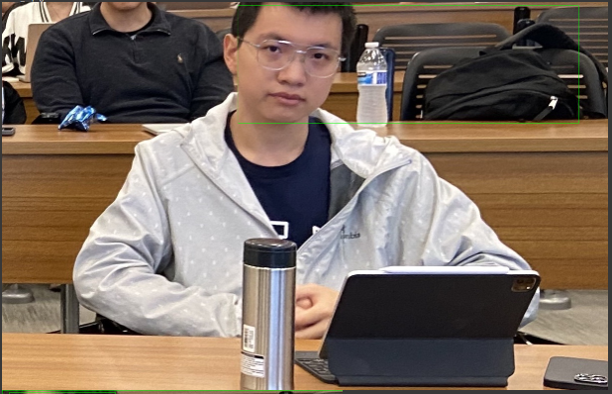
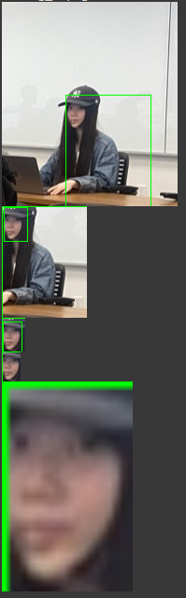
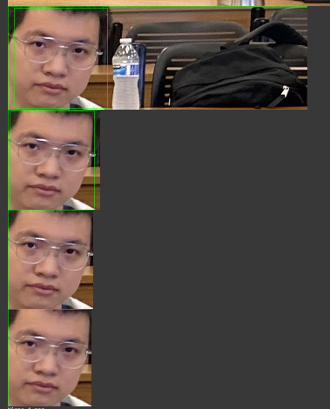
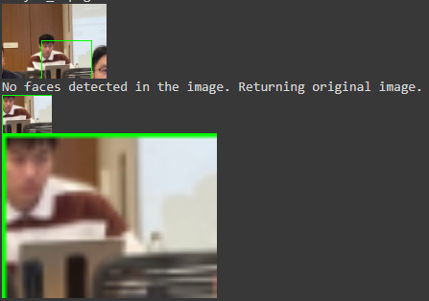
Face Detection - pre-trained DNN approach
Recursively feed the cropped image back into the face detection model until small enough a relative change (image size).
Chen Li

Slide 5

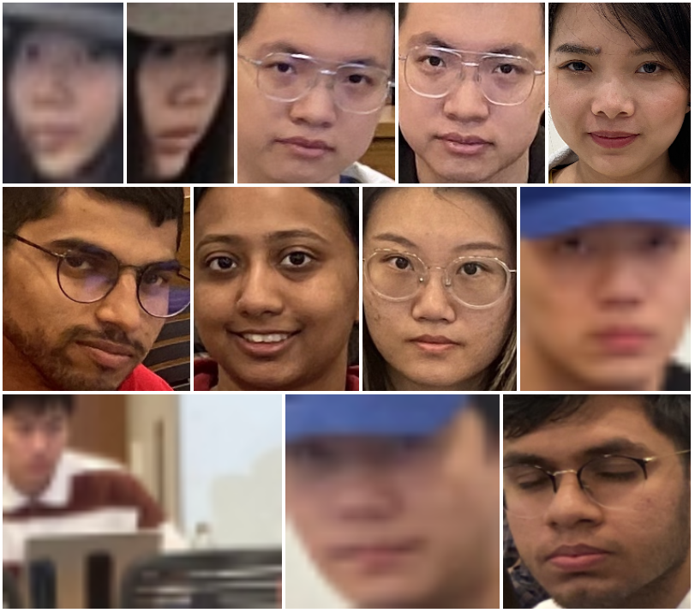
Comparison between CascadeClassifier and DNN
cv2.CascadeClassifier()
cv2.dnn
Chen Li

Slide 6
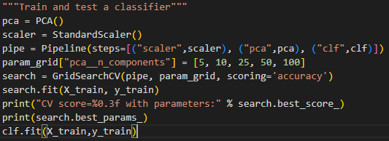
Training (Pipeline)
Training was done through a SciKit Learn Pipeline
Unification into one pipeline allowed for interfacing with hyperparameter tuning library functions (next slide)
Pipeline combines a scaling stage to normalize the data to mean 0 and variance 1, a PCA stage to select only the most impactful features, and whichever classifier (RF, SVM, KNN) was passed into the function
Chen Li

Slide 7
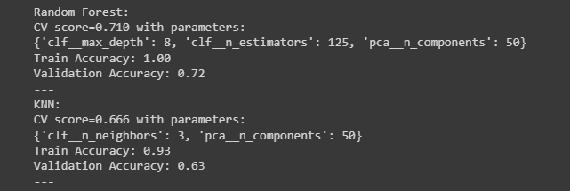
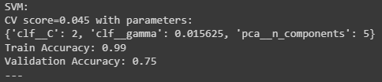
Hyperparameter Tuning
Performed using SciKit Learn’s GridSearchCV module
Takes input vectors of hyperparameter values to test and passes them into the pipelining function to automatically check the accuracy of each combination.
Reduces need for manual testing and search.
Final hyperparameter values:
Chen Li

Slide 8
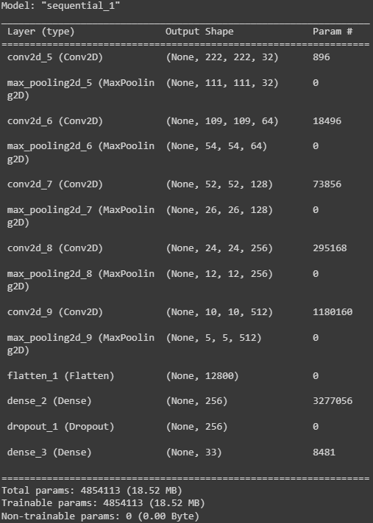
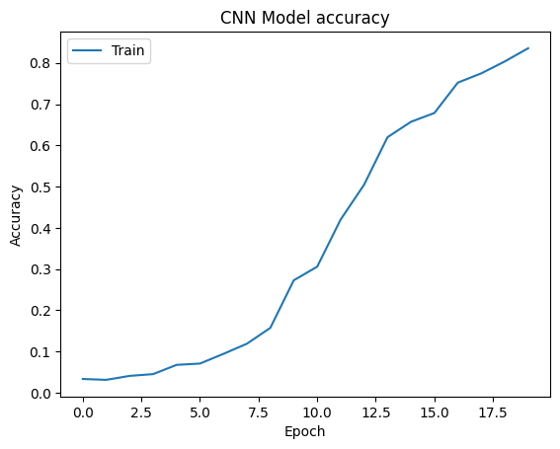
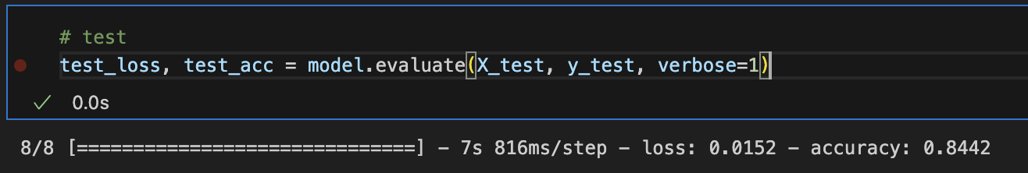
CNN Model
Advantage: can learn features related to location
Potential problem: insufficient dataset
Solution: data augmentation
Validation accuracy was 89.37%
Testing accuracy of 84.42%
Chen Li

Slide 9
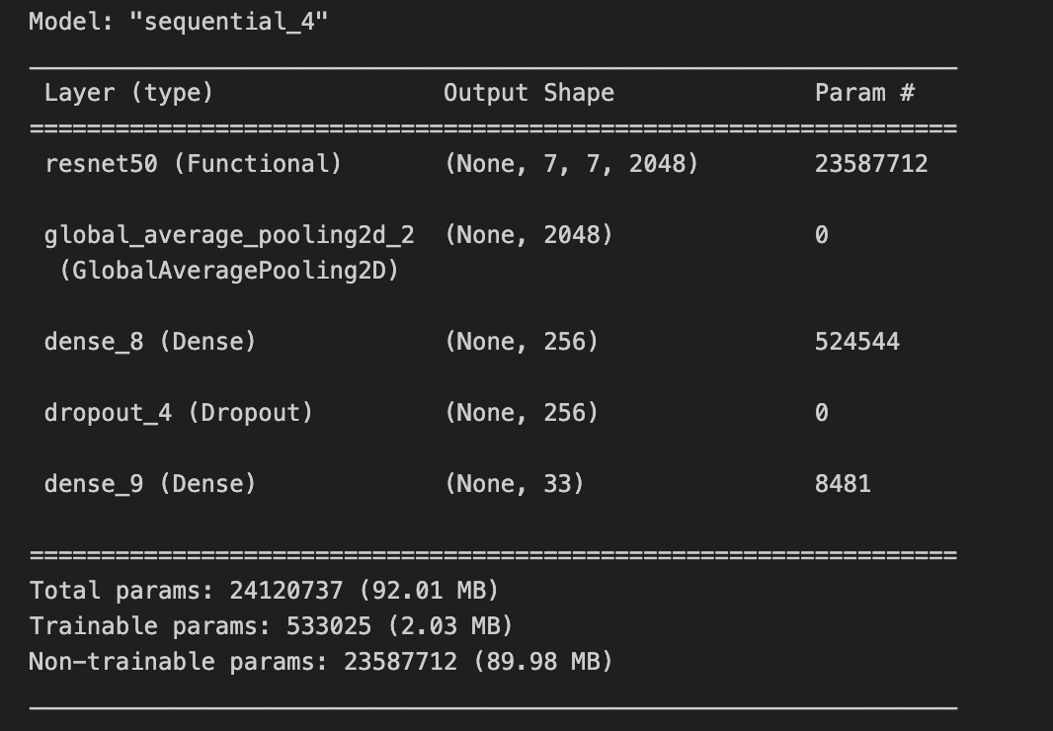
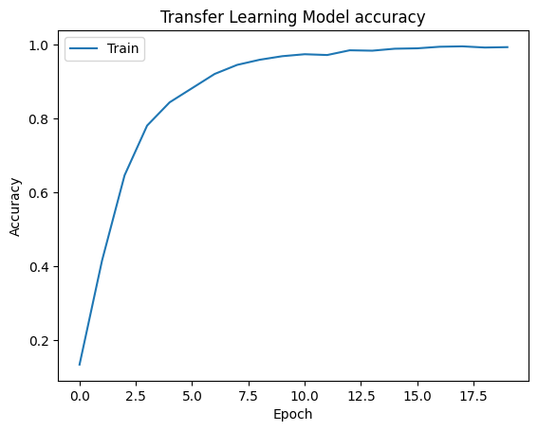
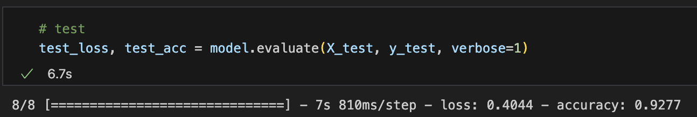
Transfer Learning(ResNet)
Advantages:
Same advantage like CNN
Easy for training
Better feature extractor
Validation accuracy: 94.53%
Testing accuracy: 92.77%

Slide 10
Challenges and Solutions
Face detection and cropping failures using a CascadeClassifier.
Solution: Attempted to tune parameters for being performance without positive results. Then explored other options, landing on a recursive dnn cropping approach.
Data augmentation selections, ranges, and when to apply it.
Solution: Took feedback from earlier presentations and decided to use smaller ranges and to apply the data augmentations after splitting the dataset to avoid overfitting.
Long training times due to grid search for hyperparameter tuning.
Solution: Reduced the search range for each hyperparameter.
Team communication and timetable scheduling
Solution: Asynchronous work style with weekly or bi-weekly meetings.
Chen Li

Slide 11
Conclusion
Validation accuracy on non-CNN models is moderate to poor:
knn = 0.63
rf = 0.72
svm = 0.75
On test dataset, accuracy:
knn = 0.52
rf = 0.51
svm = 0.61
CNN validation accuracy was 89%, with testing accuracy of 84%.
Chen Li

